Slide 1


School of Computing Science and Engineering
Course Code : E2UC401C NAME: Programming in python
Fingerprint Matching using python
Presented by:
Nisha Varshney (21SCSE1010583)
Abhinav Choudhary(21SCSE1011615)
Presented to:
Mr. Gurmeet Singh
Program Name:B.Tech(CSE)

Slide 2
Index
Abstract
Introduction
Uses of fingerprint Authentication
Features
Tools and Technology used
Code
Output
Conclusion
Program Name: B.Tech (CSE)

Slide 3
Abstract
Our aim is to create a tool in this project which can help us to identify a person’s damaged or altered fingerprint. Fingerprints are pattern of fraction of ridges which are uniquely detailed, durable over an individual’s lifetime.
Fingerprints have become more important these days as it is used almost everywhere. From our Mobiles, laptops, tablets to organisations using it for tracking attendance and managing workforce.
In our project , we are using Sokoto Conventry Fingerprint Dataset(SOCOFing) from Kaggle. Inside our dataset we have to directories, Real Fingerprints and Altered Fingerprints. Based on the level of alteration, we have three directories in the Altered Fingerprints which is Easy , Medium and Hard.
We are also using an external library opencv in which we take the altered image of the fingerprint and then we will find the real fingerprint.
Program Name: B.Tech (CSE)

Slide 4
Introduction
Fingerprint uses a statistical analysis and measurement of physical or behavioral characteristics as a security feature to authenticate and identify an individual.
Fingerprint security can be more secure than other forms of authentication, as biometric information is linked to a specific individual and therefore more difficult to steal, lose, or compromise.
Program Name: B.Tech (CSE)

Slide 5
Uses of Fingerprint Authentication
Law enforcement and public security -Fingerprints are a common method of identifying suspects and criminals
Health care – To keep track record of patient medical history
Computer systems and networks - Smartphones, laptops, and computers all often use a form of biometrics
Commercial applications -Banks and financial institutions can require fingerprint access for transactions
Program Name: B.Tech (CSE)

Slide 6
Features
Analysing data
Our tool will have to obtain the data of the real fingerprints and it will extract meaningful features known as minutia points from the fingerprint.
B. Analysing the factors
It picks out attributes such as orientation, change of ridge direction, arches, loops and whorls in the print.
It then records and stores these minutia points in order to verify the user’s identity in the future.
Program Name: B.Tech (CSE)

Slide 7
Tools and Technology Used
OpenCV: OpenCV is a Python open-source library, which is used for computer vision in Artificial intelligence, Machine Learning, face recognition, etc. In OpenCV, the CV is an abbreviation form of a computer vision, which is defined as a field of study that helps computers to understand the content of the digital images such as photographs and videos. So, import it using the import cv2 statement before using its functions.
OS : OS module in Python provides functions for creating and removing a directory (folder), fetching its contents, changing and identifying the current directory, etc. first we need to import the os module to interact with the underlying operating system. So, import it using the import os statement before using its functions.
Program Name: B.Tech (CSE)

Slide 8
Code
import os
import cv2
sample = cv2.imread(r"C:\Users\HP\Desktop\nisha project\SOCOFing\Altered\Altered-Easy\1__M_Left_little_finger_Obl.BMP")
counter = best_score = 0
filename = image = kp1 = kp2 = mp = None
for file in os.listdir(r"C:\Users\HP\Desktop\nisha project\SOCOFing\Real"):
if counter % 10 == 0:
print(counter)
print(file)
counter += 1
fingerprint_image = cv2.imread("C:\\Users\\HP\\Desktop\\nisha project\\SOCOFing\\Real\\"+ file)
Program Name: B.Tech (CSE)

Slide 9
Code
#"C:\Users\HP\Desktop\nisha project\SOCOFing\Real\100__M_Left_index_finger.BMP"
sift = cv2.SIFT_create()
keypoint_1, descriptor_1 = sift.detectAndCompute(sample, None)
keypoint_2, descriptor_2 = sift.detectAndCompute(fingerprint_image, None)
matches = cv2.FlannBasedMatcher({'algorithm': 1, 'trees': 10}, {}).knnMatch(descriptor_1, descriptor_2, k=2)
Program Name: B.Tech (CSE)

Slide 10
Code
match_points = []
for p, q in matches:
if p.distance < 0.1 * q.distance:
match_points.append(p)
keypoints = 0
if len(keypoint_1) < len(keypoint_2):
keypoints = len(keypoint_1)
else:
keypoints = len(keypoint_2)
if len(match_points) / keypoints * 100 > best_score:
best_score = len(match_points) / keypoints * 100
filename = file
image = fingerprint_image
kp1, kp2, mp = keypoint_1, keypoint_2, match_points
Program Name: B.Tech (CSE)

Slide 11
Code
print("BEST MATCH: " + filename)
print("SCORE: " + str(best_score))
result = cv2.drawMatches(sample, kp1, image, kp2, mp, None)
result = cv2.resize(result, None, fx=4, fy=4)
cv2.imshow("RESULT", result)
cv2.waitKey(0)
cv2.destroyAllWindows()
Program Name: B.Tech (CSE)

Slide 12
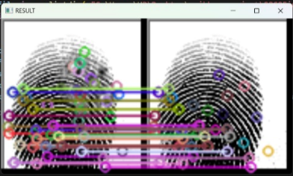
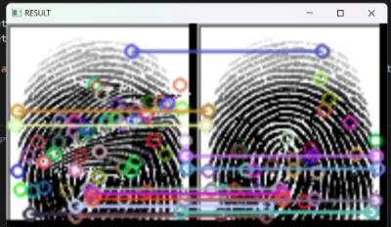
Output
Program Name: B.Tech (CSE)

Slide 13
Conclusion
After we have successfully built the project, we would be able to find the best match for a damaged fingerprint. After giving the input the system will run tests on the sample and will search for the best match form its database and give us the output.
With the help of this project, we are going to solve fingerprint recognition problem.
It will be helpful for Police investigation when the fingerprint found on the crime scene is not complete. It will run test on the incomplete portion of the fingerprint and find the criminal.
Program Name: B.Tech (CSE)

Slide 14


